Slide 1


Supervised Learning On Income Around The World (1994): “Adult Dataset” from UCI
Machine Learning Foundations
Professor Petia Georgieva
Work done by:
Beatriz Mesquita, 115367

Slide 2

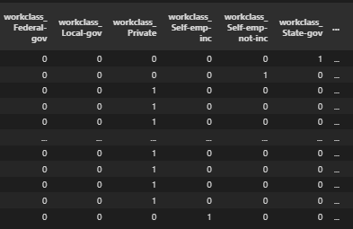
Data Preprocessing
Looking at the raw dataset, some assumptions can be made as to what can impact or not the predictive model:
Null values (‘?’)
Remove fnlwgt feature
Remove capital-gain feature
Remove capital-loss feature
Categorize hours-per-week feature
Grouping native-country feature
One-hot encoding

Slide 3
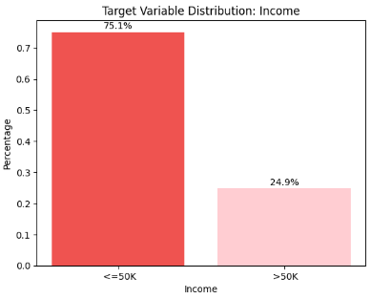
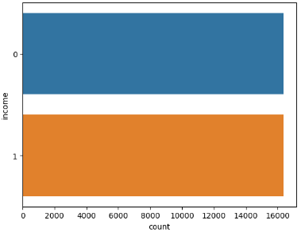
Data Visualization
SMOTE

Slide 4
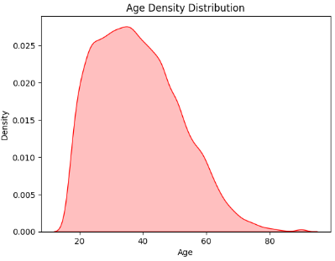
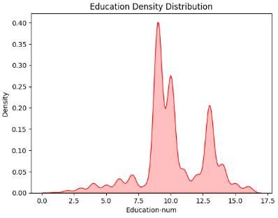
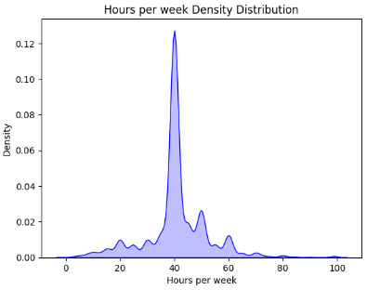
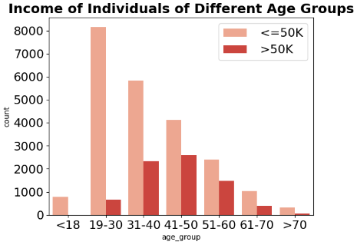
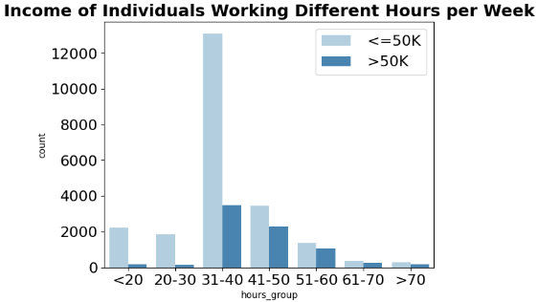
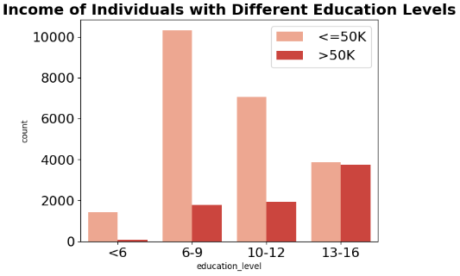
Data Visualization

Slide 5
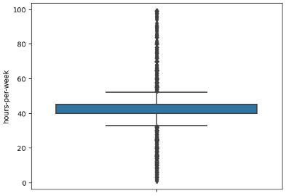
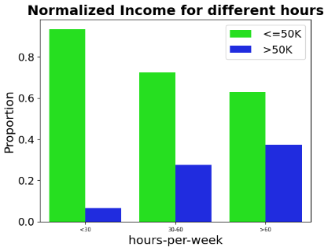
Data Visualization

Slide 6
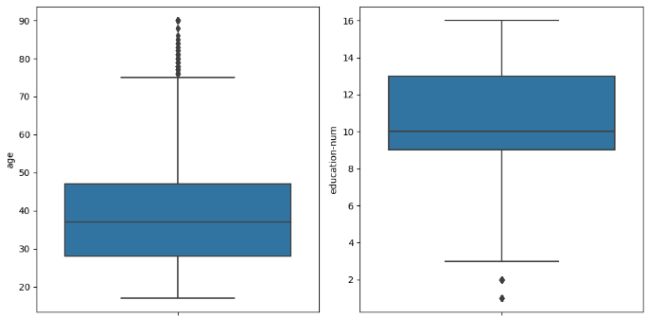
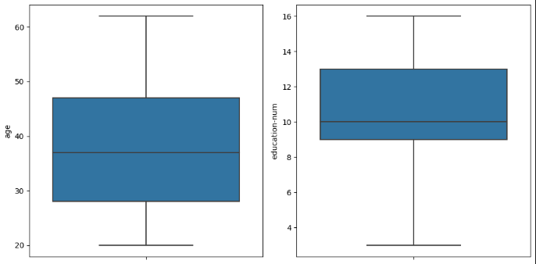
Data Visualization
Winsorizing
Inter Quantile Range

Slide 7
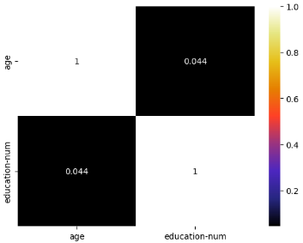
Data Visualization
Cheking for multicollinearity
Numerical Features

Slide 8
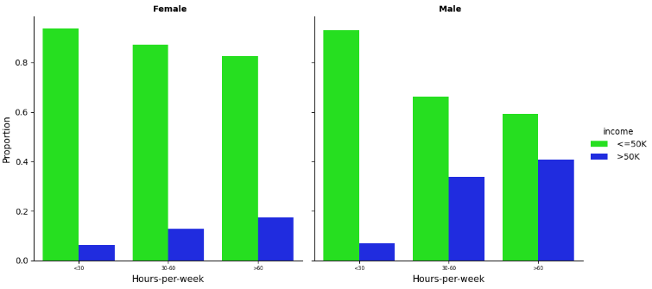
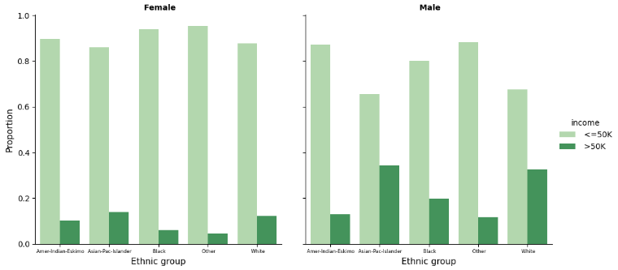
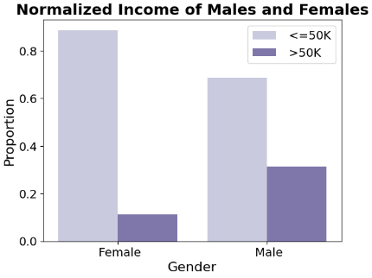
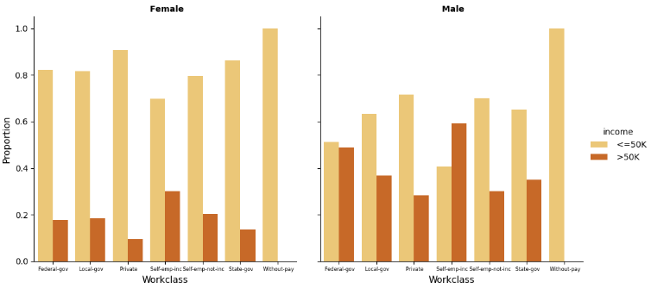
Data Visualization

Slide 9
Tools and Algorithms used
Models we used
Random Forest
Multi-Layer Perceptron (MLP)
Long short-term memory (LSTM)
What we get from each model
ClassificationReport/
PerformanceMetrics
Accuracy
ConfusionMatrix
ROC curve
9

Slide 10
Tools and Algorithms used
Train/Test split
Training set (70%)
Dataset
Validiation test (15%)
Testing test (15%)
The training set was used for fitting and the validatoin set was used for hyper-parameter tuning.
The testing set was used for validating the results.
Hyper-parameter tuning
Systematic approach

Slide 11
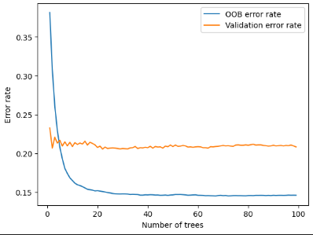
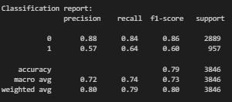
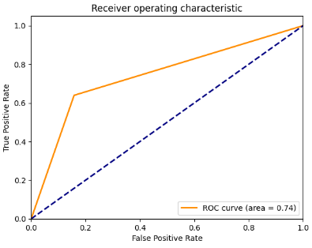
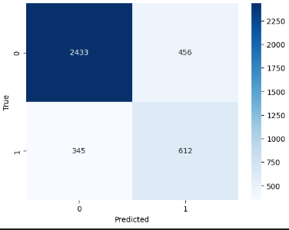
Loss Function
Results – Random Forest
ROC Curve
Confusion Matrix

Slide 12
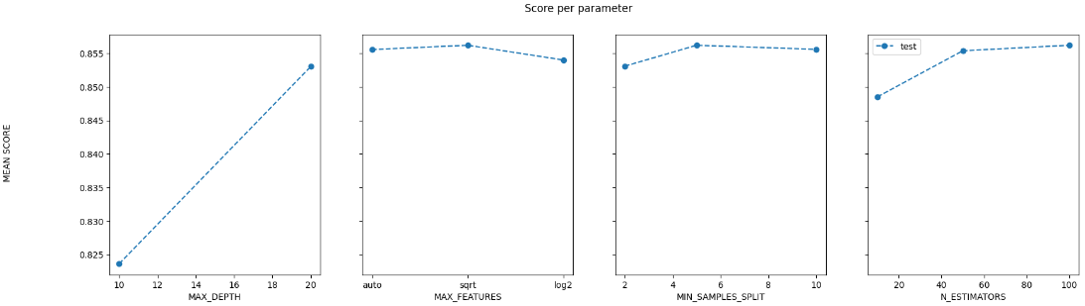
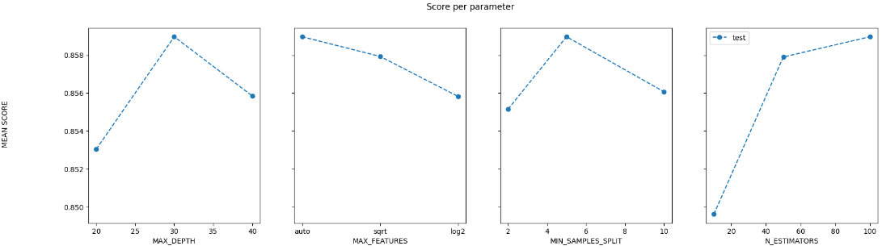
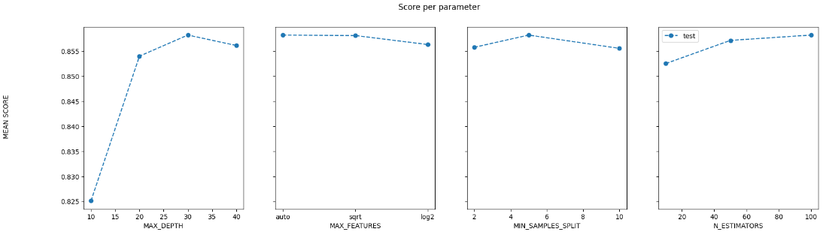
Results – Random Forest
Hyperparameters tuned:
'n_estimators
'max_depth’
'min_samples_split
'max_features’
Best values for the hyperparameters:
{'max_depth': 30, 'max_features': 'auto', 'min_samples_split': 5, 'n_estimators': 100}

Slide 13
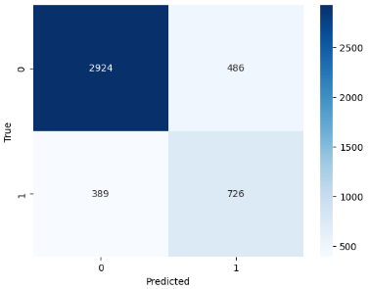
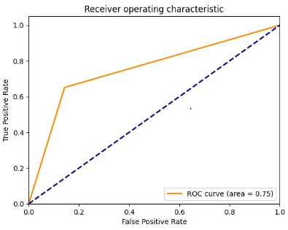
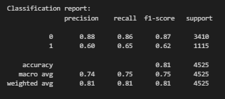
Results – Random Forest
Confusion Matrix
ROC Curve

Slide 14
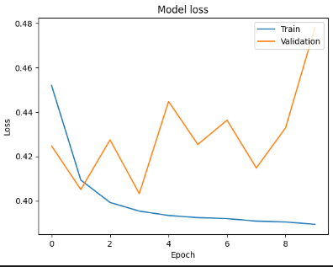
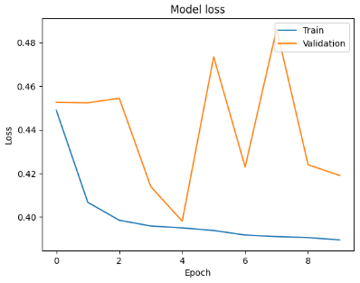
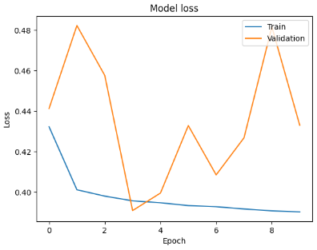

Results – MLP
model = Sequential()
model.add(Dense(h, input_shape=input_shape))
model.add(Dense(h))
model.add(Dense(1, activation='sigmoid'))
h = 8
h = 16
h = 32

Slide 15
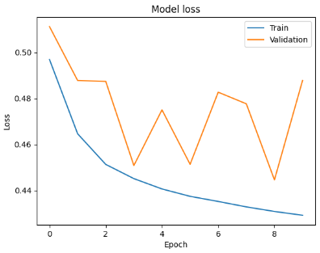
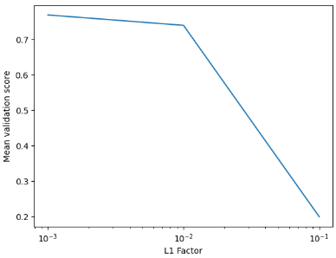
Results – MLP
model = Sequential()
model.add(Dense(h, input_shape=input_shape))
model.add(Dense(h))
model.add(Dense(1, activation='sigmoid'))
32 recurrent units + L1 regularization

Slide 16
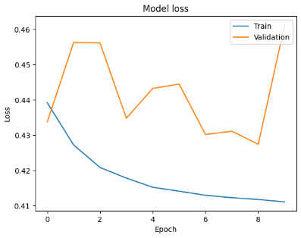
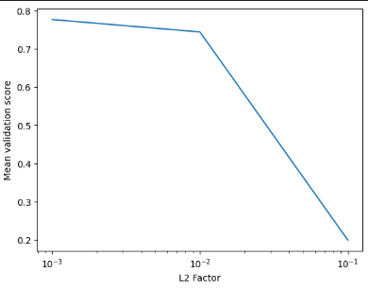

Results – MLP
model = Sequential()
model.add(Dense(h, input_shape=input_shape))
model.add(Dense(h))
model.add(Dense(1, activation='sigmoid'))
32 recurrent units + L2 regularization

Slide 17
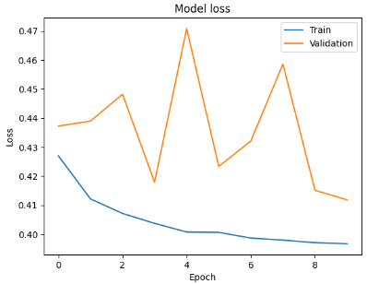
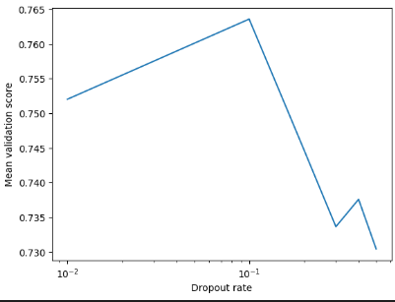
Results – MLP
model = Sequential()
model.add(Dense(h, input_shape=input_shape))
model.add(Dense(h))
model.add(Dense(1, activation='sigmoid'))
Local maximum!
32 recurrent units + Dropout

Slide 18
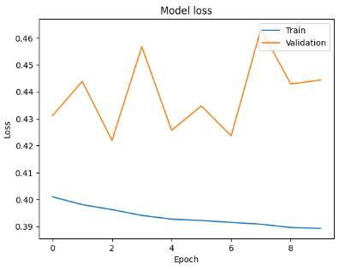
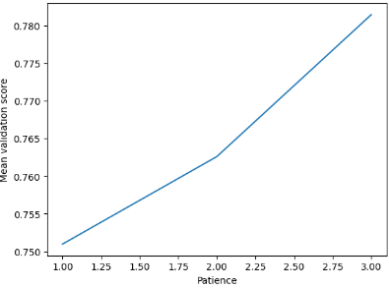

Results – MLP
model = Sequential()
model.add(Dense(h, input_shape=input_shape))
model.add(Dense(h))
model.add(Dense(1, activation='sigmoid'))
32 recurrent units + Early Stopping

Slide 19

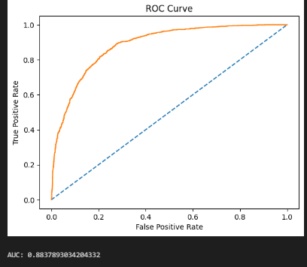
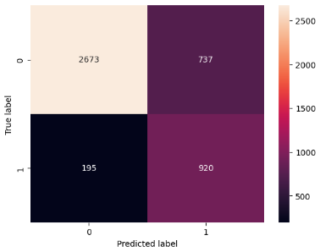
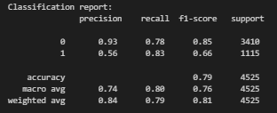
Results – MLP
ROC Curve
Confusion Matrix

Slide 20
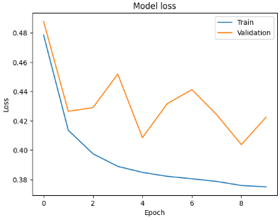
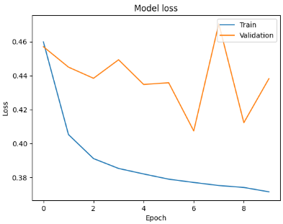
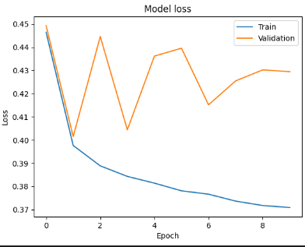

model = Sequential()
model.add(LSTM(h, input_shape=input_shape, return_sequences=True))
model.add(LSTM(h))
model.add(Dense(1, activation='sigmoid'))
Results – LSTM
h = 8
h = 16
h = 32

Slide 21
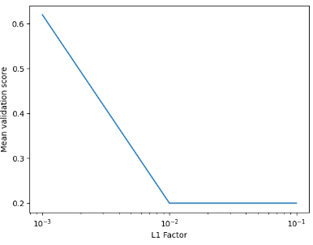
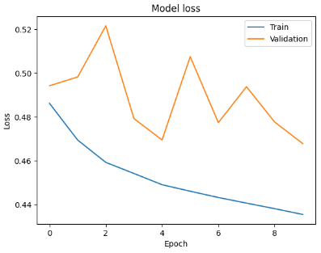
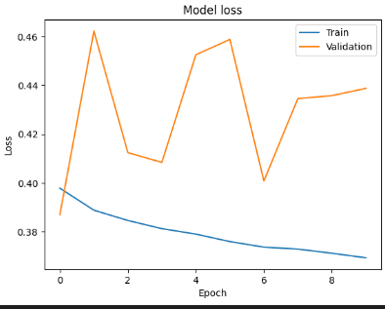
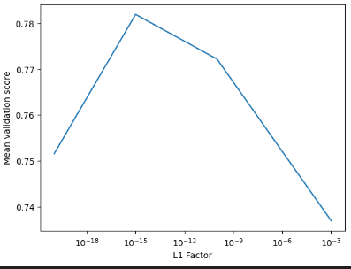
model = Sequential()
model.add(LSTM(h, input_shape=input_shape, return_sequences=True))
model.add(LSTM(h))
model.add(Dense(1, activation='sigmoid'))
Results – LSTM
32 recurrent units + L1 regularization

Slide 22

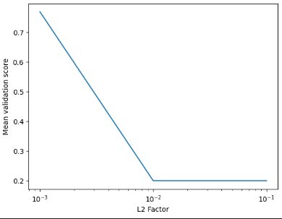



model = Sequential()
model.add(LSTM(h, input_shape=input_shape, return_sequences=True))
model.add(LSTM(h))
model.add(Dense(1, activation='sigmoid'))
Results – LSTM
32 recurrent units + L2 regularization

Slide 23


model = Sequential()
model.add(LSTM(h, input_shape=input_shape, return_sequences=True))
model.add(LSTM(h))
model.add(Dense(1, activation='sigmoid'))
Results – LSTM
32 recurrent units + Dropout

Slide 24



model = Sequential()
model.add(LSTM(h, input_shape=input_shape, return_sequences=True))
model.add(LSTM(h))
model.add(Dense(1, activation='sigmoid'))
Results – LSTM
32 recurrent units + Early Stopping

Slide 25




Results – LSTM
ROC Curve
Confusion Matrix

Slide 26


Conclusions
We proposed a novel feature engineering approach that extracts meaningful information from the categorical attributes and reduces the dimensionality of the data.
We provided a comprehensive analysis of the factors that influence income level, such as education, occupation, gender, age, and marital status.
Using deep learning algorithms does exactly mean that its results are better than machine learning algorithms
Random Forest is less prone to overfitting and can be easier to interpret than deep learning models.
MLP and LSTM can require large amounts of data and computational resources to train effectively. They may also require careful tuning of hyperparameters to achieve good performance.
Results of deep learning can be improved using another set of parameter testing and different neural network architecture.

